Slide 1



Slide 2
Help2GetHelp
by RoboSmile
MEXA Hackathon

Slide 3

Help2GetHelp - RoboSmile
Help2GetHelp: helping people to express their condition
RoboSmile members (in alphabetical order):
Limou Dembele
Adam Harris. Conceptualisation, Software, Writing (github.com/AdamLoydHarris, x.com/AdamLoydHarris)
Clàudia Llinares. Investigation, Writing (www.linkedin.com/in/claudia-llinares)
María Navas-Loro. Software, Writing (https://mnavasloro.github.io/aboutme/)
Luis Torrao. Software (https://www.linkedin.com/in/luistorrao/)

Slide 4
Problem Statement
Alexithymia: difficulties identifying and describing feelings. Affects approximately 30-50% of patients with clinical mental health conditions (McGillivray et al., 2017).
Alexithymia is a transdiagnostic risk factor for a variety of emotion-based psychopathologies, such as depression and anxiety (Preece, D. et al., 2024). (Li et al., 2015).
The presence of alexithymia can present a barrier to psychotherapeutic treatment (Lumley et al., 2007)
Notes:
Alexithymia and the risk of psychopathology appears to be explained by emotional regulation deficits. These deficits can impair subsequent emotional regulation, predisposing individuals to disorders characterized by dysregulated affect levels (Gross, 2015; Preece et al., 2022).

Slide 5
Impact of Alexithymia on the Patient - Therapist Relationship
Frustration and negative perceptions: Patients with alexithymia often experience shame and frustration in therapy due to negative past experiences, leading them to believe they cannot succeed (Da Silva et al., 2018)
Therapist bias: Clinicians may develop negative perceptions of alexithymic patients, considering them unsuitable for therapy
Notes:
(Risk Assessment: Explain any risks or hazards of the technology in the proposed solution. What types of errors could happen?)
(Risk Scoring and Mitigation: What types of ideas does the team have for addressing identified risks? Which ones are most critical to be addressed?)

Slide 6
Our goal:
Use fine-tuned LLMs to help patients identify and express their mental state clearly in early stages of mental health care.

Slide 7


Concept
In the UK, a GP appointment is just 15 minutes.
LLMs can converse with people over long time scales (asynchronously).
This will help patients refine their thoughts outside of a potentially stressful clinical setting.
The benefit is twofold:
The patient understands better their own situation and how to express it to others, empowering them to seek help
The summary can be helpful to a doctor for understanding the context of the patient

Slide 8



Solution Overview: Innovation
A web service based on LLMs with which the patient can gradually work out how to express themselves.
The LLM can then write a personalised message to a mental health professional to get the ball rolling

Slide 9



Technical Approach: Model and Method
Gemini API with zero or few- shot prompting was used for:
Simulating texts from patients with various mental health issues, with varying levels of communication ability.
Summarization of the text entries.
We additionally used:
Machine learning algorithms (sklearn) to build classification models
Flask to make a web interface for our tool.
Notes:
Model and Method: Describe the technical framework or model used. What technologies, APIs, or tools did you use?

Slide 10
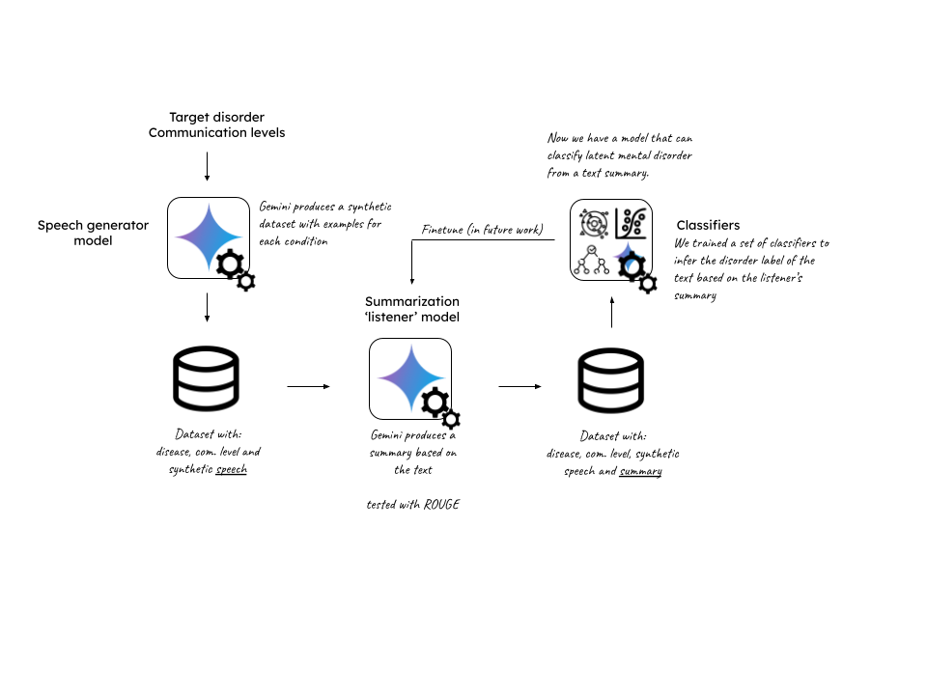
Technical Approach: Development Process
We also checked different datasets, such as the depression dataset. For summarization evaluation we used ROUGE for summarization and precision/recall/F1-measure for classification.
Notes:
Scheme: https://docs.google.com/drawings/d/13SchxSQB23ZvY7mZnqgTYlqdOjL547GGviyL3v3M4RE/edit?usp=sharing
Depression, anxiety, bipolar, ptsd, ocd, Development Process: Outline the key steps in development your solution. How was the model implemented, tested, or validated? Describe data sets accessed or used.

Slide 11
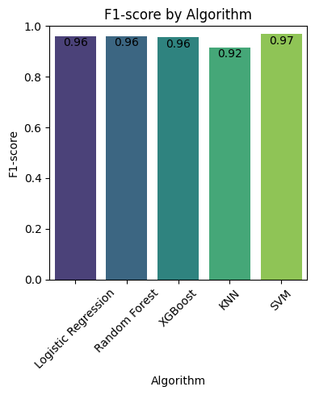
Evaluation/Results
Performance of summarised simulated agent text: ROUGE
Classification performance:
Precision
Recall
f1-measure
Longer timescale: how many people that use the tool go on to access mental healthcare.
User can keep interacting + refining until they are satisfied
Notes:
(Validation and Metrics: Present any preliminary results or metrics (accuracy, effectiveness, scalability, etc) that are most relevant to your project.)

Slide 12
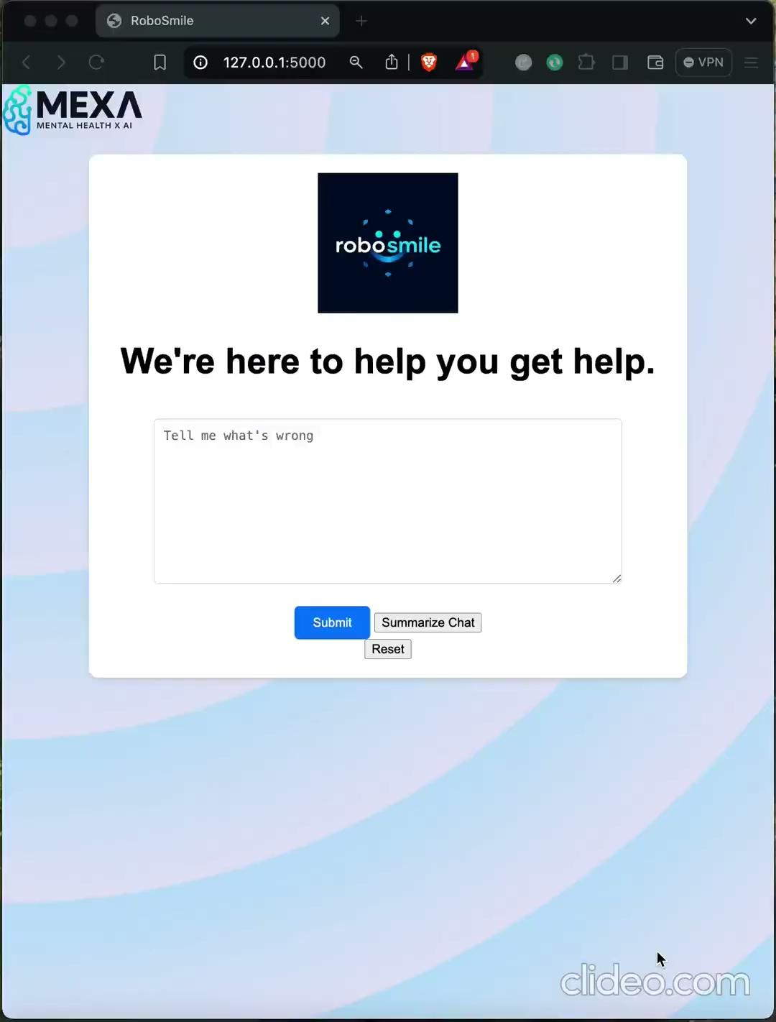
Demo
Notes:
(If your project is at a stage or of a type where a live demo is possible, provide a live demo or video walkthrough of the solution in action.)

Slide 13
Technical Approach: Challenges Faced
Quota reached: since we wanted to create synthetic data, we sent too many requests to Gemini.
→ This was later solved.
Our simulated population's generated texts contain offensive material, and the GEMINI api blocks it.
→ We had to limit the generation to non-offensive words, even if this is biased with regard to real patients.
List kept falling out of character during user interaction.
→ Refined prompting between user inputs

Slide 14
User Experience and Interface
The patient can easily interact with the web service.
When the user is happy with the summary, they can share it with the clinician. The patient is the ultimate judge of the model’s success.
Notes:
(User Interface/Interaction: Show how users (patients, clinicians, researchers, etc) would interact with the solution. What would it look like? How would it work?)
(Human-AI Interface Points: Demonstrate at which boundaries humans and AI work together. What is the role of human intervention?)

Slide 15
In the real world
Our service will help patients to better understand their condition and communicate this with practitioners.
Patient associations and health services would be key to spread the word.
Since the chat prompting format has become widely popular lately, the service will be comfortable and familiar to many potential users.
Notes:
(Real World Application: Explain how this solution will impact real world mental health care. How would it be implemented?)
How will people know about it/ how will people access it? Are people comfortable using AI tools? Is this even across all demographics?
In order to get to demographics less keen to computer interaction, we could add voice to the system and implement it like a phone-call service.

Slide 16
Identifying Risks
Variability in treatment responses: - Some patients actively seek help, while others avoid it due to cognitive preferences or negative experiences
System errors: - Algorithms might fail to correctly identify key features traits, leading to inappropriate solutions
- Even in our limited usage we’ve seen false-recognition effects. If the user describes a few symptoms of depression, the summary will likely include some extra
Notes:
(Risk Assessment: Explain any risks or hazards of the technology in the proposed solution. What types of errors could happen?)
(Risk Scoring and Mitigation: What types of ideas does the team have for addressing identified risks? Which ones are most critical to be addressed?)

Slide 17
Risks Mitigation
Personalized solutions. Collaborate with clinicians to: - Identify specific alexithymia traits/subtypes - Design tailored strategies based on these profiles
Safeguarding to encourage immediate help if people seem to be a risk to themselves (emergency services, hotlines)
Notes:
(Risk Assessment: Explain any risks or hazards of the technology in the proposed solution. What types of errors could happen?)
(Risk Scoring and Mitigation: What types of ideas does the team have for addressing identified risks? Which ones are most critical to be addressed?)

Slide 18
Future Work
Create more advanced agents to simulate the different discourse potential patients could produce, and use it to fine-tune a model.
Add voice to the system to reach people reluctant to computer-interaction.
Allow different styles of summary. For instance, a more personal message to send to a friend.
Think explicitly about sociocultural barriers to emotional expression
Notes:
(Next Steps: Describe the next steps needed to improve this solution or fully implement it, or talk about what was learned and what a new, different solution might look like instead.)

Slide 19
References
Alexithymia: One of the most impactful health conditions you’ve never heard of. (s/f). Behavioral Health Consulting Solutions. https://www.bhcsmt.com/blog/alexithymia-one-of-the-most-impactful-health-conditions-youve-never-heard-of
Da Silva, A. N., Vasco, A. B., & Watson, J. C. (2018). Alexithymia and emotional processing: a longitudinal mixed methods research. Research in Psychotherapy Psychopathology Process and Outcome. https://doi.org/10.4081/ripppo.2018.292
Gross, J. J. (2015). Emotion regulation: Current status and future prospects. Psychological Inquiry, 26(1), 1–26. https://doi.org/10.1080/1047840x.2014.940781
Leweke, F., Leichsenring, F., Kruse, J., & Hermes, S. (2012). Is alexithymia associated with specific mental disorders? Psychopathology, 45(1), 22–28. https://doi.org/10.1159/000325170
Li, S., Zhang, B., Guo, Y., & Zhang, J. (2015). The association between alexithymia as assessed by the 20-item Toronto Alexithymia Scale and depression: A meta-analysis. Psychiatry Research, 227(1), 1–9. https://doi.org/10.1016/j.psychres.2015.02.006
Lumley, M. A., & Norman, S. (1996). Alexithymia and health care utilization. Psychosomatic Medicine, 58(3), 197–202. https://doi.org/10.1097/00006842-199605000-00001
McGillivray, L., Becerra, R., & Harms, C. (2017). Prevalence and demographic correlates of alexithymia: A comparison between Australian psychiatric and community samples: Prevalence of alexithymia in Australian samples. Journal of Clinical Psychology, 73(1), 76–87. https://doi.org/10.1002/jclp.22314
Preece, D. A., Mehta, A., Becerra, R., Chen, W., Allan, A., Robinson, K., Boyes, M., Hasking, P., & Gross, J. J. (2022). Why is alexithymia a risk factor for affective disorder symptoms? The role of emotion regulation. Journal of Affective Disorders, 296, 337–341. https://doi.org/10.1016/j.jad.2021.09.085
Preece, D. A., Mehta, A., Petrova, K., Sikka, P., Pemberton, E., & Gross, J. J. (2024). Alexithymia profiles and depression, anxiety, and stress. Journal of Affective Disorders, 357, 116–125. https://doi.org/10.1016/j.jad.2024.02.071
Lumley MA, Neely LC, Burger AJ. The assessment of alexithymia in medical settings: implications for understanding and treating health problems. J Pers Assess 2007;89:230–46. 12.
Ogrodniczuk JS, Piper WE, Joyce AS. Effect of alexithymia on the process and outcome of psychotherapy: a programmatic review. Psychiatry Res 2011;190:43–8.

Slide 20
Plans to Embed Lived Experience
People who lived the experience would be key to the testing and improvement of the service
Notes:
(Does the project align with the needs and priorities of people with lived experience of anxiety/depression/psychosis?)
(Who will decide what is measured? How will measurements be used and by whom?)
(Where can you meaningfully involve perspectives of people with lived experience to shape the direction of the project?)
(How will you engage lived experience experts?)

Slide 21
Relationship with the Healthcare System
Depending on alexithymia traits, two patterns emerge:
Difficulty identifying feelings: - More likely to seek outpatient treatment. - Increased use of over-the-counter pain relievers. - Frequent participation in psychotherapy.
Externally oriented thinking: - Less likely to attend therapy or outpatient treatment. - More likely to engage in preventive health services
Notes:
(Risk Assessment: Explain any risks or hazards of the technology in the proposed solution. What types of errors could happen?)
(Risk Scoring and Mitigation: What types of ideas does the team have for addressing identified risks? Which ones are most critical to be addressed?)

